Slide 1
MAN 7916 Session 2: Corpus Collection
Aaron McKenny
1/15/2025

Slide 2
AGENDA
1 Homework review
2 This week’s readings
3 How do websites/APIs work?
4 In class activity
5 For next week

Slide 3
Part I: What is the Dean Thinking?
Questions?
Points of Confusion?
Walkthrough

Slide 4
Part II: Subfield Publications
Questions?
Points of Confusion?
Walkthrough

Slide 5
AGENDA
1 Homework review
2 This week’s readings
3 How do websites/APIs work?
4 In class activity
5 For next week

Slide 6
Neuendorf Chapter 3: Message Units and Sampling
What is unitization and why does it matter?
How do we choose the right unit of sampling/data collection/analysis?
One-size-fits-all?
What is the distinction between emic and etic unitization?
What are the consequences for other methodological decisions?
What does it mean to report the reliability of unitization? Is this important?
What is the distinction between availability- and exposure-based populations?
In what ways is sampling in content analysis the same/different than in other methods?

Slide 7
Neuendorf Chapter 7: CA in the Interactive Media Age
In what ways does interactive media introduce new…
… opportunities for researchers?
… challenges for researchers?
What kinds of questions do we need to consider when collecting/analyzing interactive media?
How might generative AI contribute to these opportunities/challenges?

Slide 8
Han & Anderson: Web Scraping for Hospitality Research
What are some of the challenges of scraping dynamic content?
What is Selenium and WebDriver and how do these help us to obtain dynamic content?
While the article focuses on Hospitality, what can we learn about the use of scraped data for management research?

Slide 9
Video Contents
What are APIs?
How do they work?
What are proxy servers?
What is their role in web scraping?
What are some of the legal/ethical concerns with regards to scraping?
What are some good practices to stay on the right side of the law/ethics?

Slide 10
Guiding Principles
Read the website’s Terms of Use/robots.txt
Only scrape publicly available data
Minimize the impact of your scraping on the host
Don’t rescrape data that has already been scraped
Test your scraper before launching big runs
Scrape at a reasonable pace – throttle yourself
Be careful when collecting sensitive data (even when publicly available)
IRB
Legal concerns
Better safe than sorry – talk with your coauthors about legal & ethical concerns
Not exhaustive and certainly not legal advice

Slide 11
AGENDA
1 Homework review
2 This week’s readings
3 How do websites/APIs work?
4 In class activity
5 For next week

Slide 12

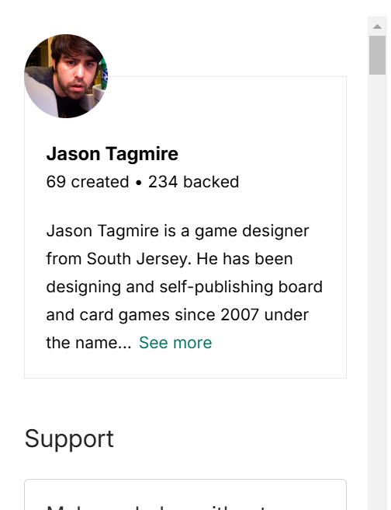
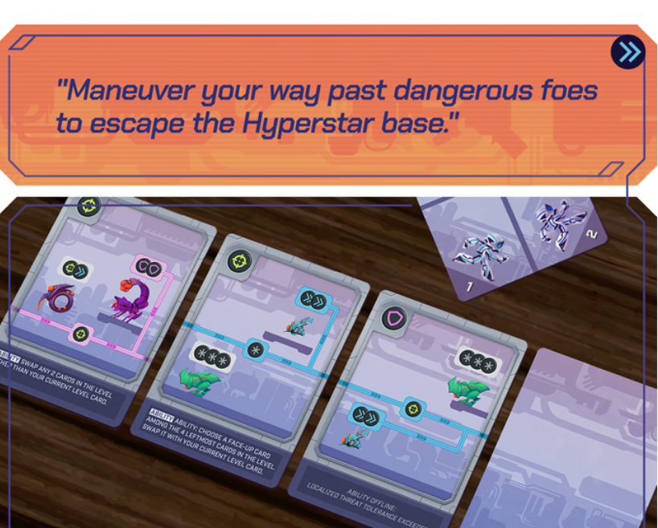
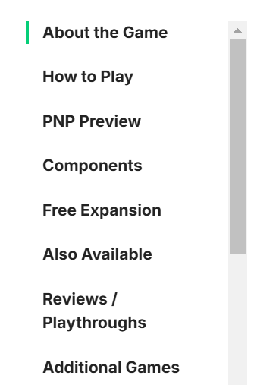
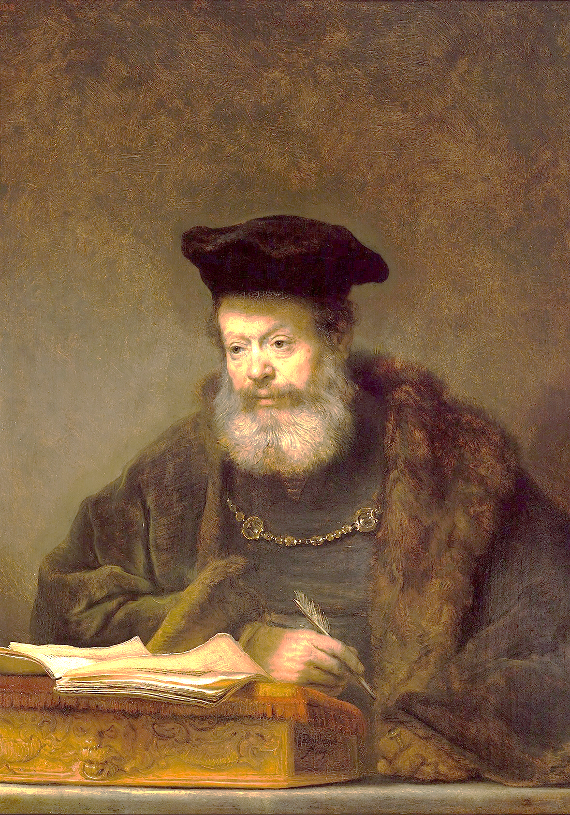
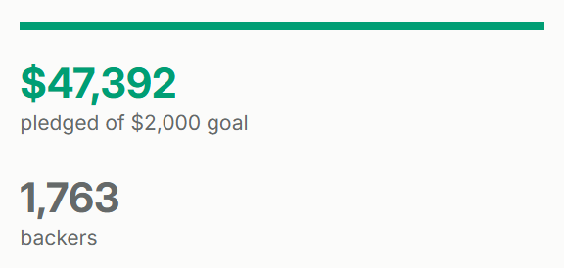
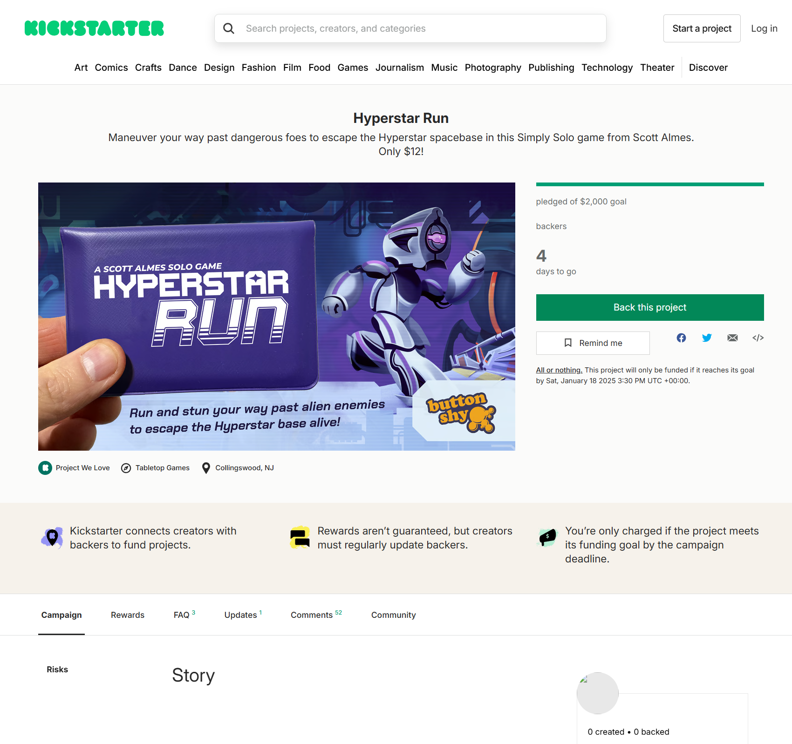

OK… here’s what a campaign page looks like with a few static details.
OK… here’s that campaign’s details.
How do (many) websites work?
I want to see the Hyperstar Run Kickstarter campaign page
CORS API: Fill this template with the Hyperstar Run campaign details

Slide 13





How do APIs work?
Sure… here’s a key to give you permission/track what you download
Will you share your tweet data with me?
X server: Send me all tweets from @HowIBuiltThis from 7/1/2016 until today…
Here’s my key
HIBT Tweets

Slide 14
Let’s take a look at a website loading in real-time

Slide 15
AGENDA
1 Homework review
2 This week’s readings
3 How do websites/APIs work?
4 In class activity
5 For next week

Slide 16
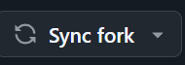
You will need to…
Resync your local MAN7916 environment with mine (if you haven’t recently)
“Sync fork” on GitHub.com
Git pull
Activate your virtual environment
source ./.venv/bin/activate (Mac/Linux/WSL)
.\.venv\Scripts/activate (Windows)
Download new packages
pip install -r requirements.txt

Slide 17
Part 1 – Kickstarter Data in a notebook
Create a Jupyter Notebook (.ipynb) in your ‘scratch’ folder
Visit Kickstarter.com and choose a campaign
Get its URL
Use ‘requests’ to try to get the campaign story text from the URL
What do you find?
Verify that you still can access the Kickstarter campaign

Slide 18
Part 2 – Kickstarter Data via Browser Automation
Create a standard Python (.py) file in your ‘scratch’ folder
Copy the contents of the browser_automation.py template into the new file and test it
Iteration 1:
Change the URL to be the campaign URL
Is the story in the page_content?
with open(“filename”, “r”, encoding=“utf-8-sig”) as outfile:
outfile.write(page_content)

Slide 19
Part 2 – Kickstarter Data via Browser Automation
Create a standard Python (.py) file in your ‘scratch’ folder
Copy the contents of the browser_automation.py template into the new file and test it
Iteration 2:
Switch the order of:
page_content = await page.get_content()
_ = input("Press Enter to continue...")
Is the story in the page_content now?
Is this a scalable process?

Slide 20
Part 2 – Kickstarter Data via Browser Automation
Create a standard Python (.py) file in your ‘scratch’ folder
Copy the contents of the browser_automation.py template into the new file and test it
Iteration 3:
Change how we ‘wait’:
Comment out: _ = input("Press Enter to continue...")
Add a wait_for call to wait for the story data to be loaded
before retrieving page_content
Verify the story is in the page_content.
Save the page_content to a text file.

Slide 21
Part 3 – Kickstarter Data Parsing
Create a Jupyter Notebook (.ipynb) in your ‘scratch’ folder
Read the contents of the saved Kickstarter content
Use BeautifulSoup to extract:
Story
Images
Rewards

Slide 22
Part 4 – API Access to OpenAI (of ChatGPT Fame)
Create a .env file in your root MAN7916 directory
In the .env file, put:
OPENAI_KEY = “(MY_KEY)”
Replace (MY_KEY) with the key I give you in class
Run the get_environment_variables.py file from the templates directory
What happened?
Why might this be important/better than putting the key in your code directly?

Slide 23
Part 4 (continued) – API Access to OpenAI
Create a Jupyter Notebook (.ipynb) in your ‘scratch’ folder
Paste in the get_environment_variables.py code and ensure it works
Try running an API request with the key
Add: openai_key = os.getenv(“OPENAI_KEY”)
Change: headers = {"Content-Type": "application/json“, “Authorization”: f”Bearer {openai_key}”}

Slide 24
Part 4 (continued) – API Access to OpenAI
Create a Jupyter Notebook (.ipynb) in your ‘scratch’ folder
Paste in the get_environment_variables.py code and ensure it works
Try running an API request without using the key
import requests
url = "https://api.openai.com/v1/chat/completions"
headers = {"Content-Type": "application/json"}
data = {"model": "gpt-4o-mini", "messages": [{"role": "user", "content": "Say this is a test!"}], "temperature": 1}
response = requests.post(url, headers=headers, json=data)

Slide 25
Part 4 (continued) – API Access to OpenAI
Make the API call a function
Accept as input the “prompt”
Return GPT-4o-mini’s response as the output
Call the function with a few different prompts as a test

Slide 26
Part 5 – Browser Automation + CORS API calls
This is going to be a watch-me demonstration
Complexity is much higher
Considerably harder to execute/troubleshoot
Pros/Cons versus browser automation

Slide 27
AGENDA
1 Homework review
2 This week’s readings
3 How do websites/APIs work?
4 In class activity
5 For next week

Slide 28
Manual Content Analysis
Codebook
Manual Coding
Don’t wait until the last minute to work on this
Consider reading assignment tonight to ensure you know what is involved
This assignment will take more time than usual to do well

